Slide 1
Smart Agriculture Control
Students : Syed Shahir & Syed Yousaf
Course Instructor : Microprocessor & Interfacing
Course Code : CPE342

Slide 2
Outcome
Introduction
Component
Circuit diagram
Working
Feature Advancement

Slide 3
Introduction
Smart Agriculture Control Project
This project uses technology to help farmers by automating and optimizing key farming tasks.
It monitors temperature, soil moisture, and humidity, and automatically controls a water pump and fan to maintain optimal growing conditions.
The system displays real-time data on an LCD screen, performs scheduled tasks, and optimizes energy use, making farming more efficient, productive, and sustainable.
This is simulation based project

Slide 4
Components
For simulation Proteus 8.13 is used
For coding Arduino IDE is used
For Hardware the following components can be utilized
Arduino Uno: Central processing unit
LM35 Temperature Sensor: Measures temperature
Soil Moisture Sensor: Measures soil moisture(LM393 based design)
Humidity Sensor: Monitors humidity(DHT11 can be used)
DS1307 RTC Module: Real-time clock for scheduling

Slide 5
Component
LCD Display (20x4): Shows data
Relays (5V): Controls water pump and fan
12V DC Fan: Provides ventilation
12V Water Pump: Pumps water
Power Sources: 12V batteries

Slide 6
Purpose
Arduino Uno: It's like the brain that controls everything.
LM35 Temperature Sensor: Tells us how hot or cold it is.
Soil Moisture Sensor: Checks if the soil has enough water for the plants.
Humidity Sensor: Keeps an eye on how damp the air is.
DS1307 RTC Module: Makes sure everything happens at the right time, like watering plants.

Slide 7
Purpose
LCD Display (20x4): Shows us what's going on, like the temperature or moisture levels.
Relays (5V): Helps turn things on and off, like the water pump or fan.
12V DC Fan: Keeps the air moving to help plants breathe.
12V Water Pump: Pumps water to the plants when they need it.
Power Sources: These are like the batteries that keep everything running smoothly.

Slide 8
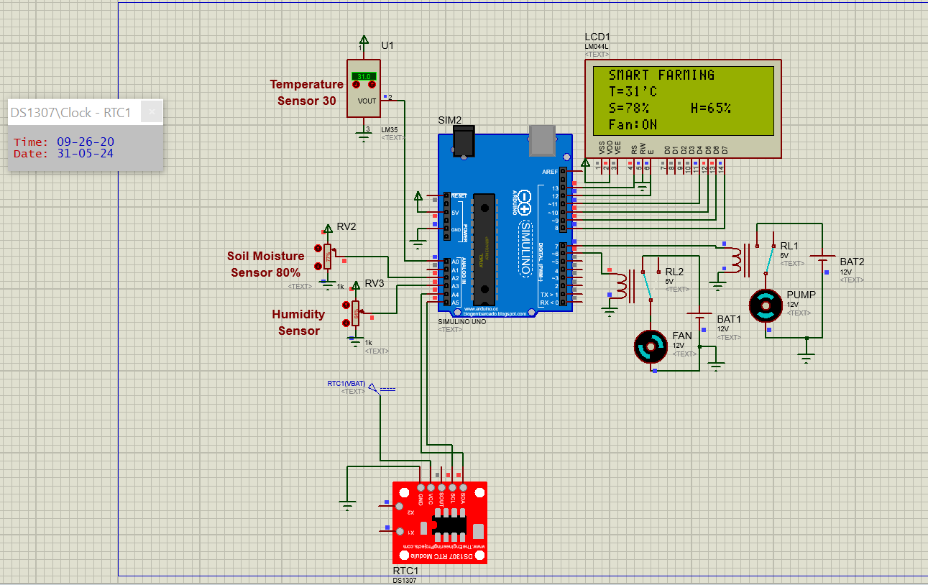
Circuit Diagram
Notes:
Pin 4: RS, register select that toggles between instruction and data register (0: instruction mode, and 1: data mode). Pin 5: RW or R/W, Read/Write (0: Write, 1: Read). Pin 6: E, Enable, active high to enable operations. Pins 7-14: D0-D7, in that order representing either data or instruction sequences.

Slide 9
Use Case
The function of this project is to make farming easier and more efficient for farmers. It does this by:
Monitoring temperature, soil moisture, and humidity to ensure optimal growing conditions for plants.
Using a real-time clock to schedule tasks like watering at the right times.
Displaying important information on an LCD screen for easy monitoring.
Automatically controlling devices like the water pump and fan to provide the necessary conditions for plant growth.
Ultimately, the goal is to help farmers manage their crops more effectively, leading to better yields and healthier plants.

Slide 10
Future Advancement
Data Logging: Record and analyze data for trends and predictions.
Connect to Weather: Adjust based on weather forecasts.
Add a humidity sensor to make decisions based on humidity:
Add Sensor: Measure air humidity.
Set Thresholds: Define ideal humidity levels.
Automate Actions:
Turn on misting if humidity is low.
Activate fans if humidity is high.

Slide 11
Thanks!!!

